Slide 1


Human Trafficking
Rosy & Mayuri

Slide 2

What is Human Trafficking??
The action or practice of illegally transporting people from one country or area to another, typically for the purposes of forced labor or commercial sexual exploitation.

Slide 3
DU Human Trfficking Center (HTC)
http://humantraffickingcenter.org/who-we-are/
The HTC is a nonprofit research aim is to provide research raises public awareness about the Trafficking Problem.

Slide 4
Research Questions ??
Objectives:
Interactive Data Visualization Graph from Origin to Destination Country.
Visualizing Tier Rankings of all Countries.
Statistical graphs of Type of Trafficking.
Below link is the map that envision it to look similar to:
http://www.digitalattackmap.com/#anim=1&color=0&country=ALL&list=1&time=17629&view=map

Slide 5
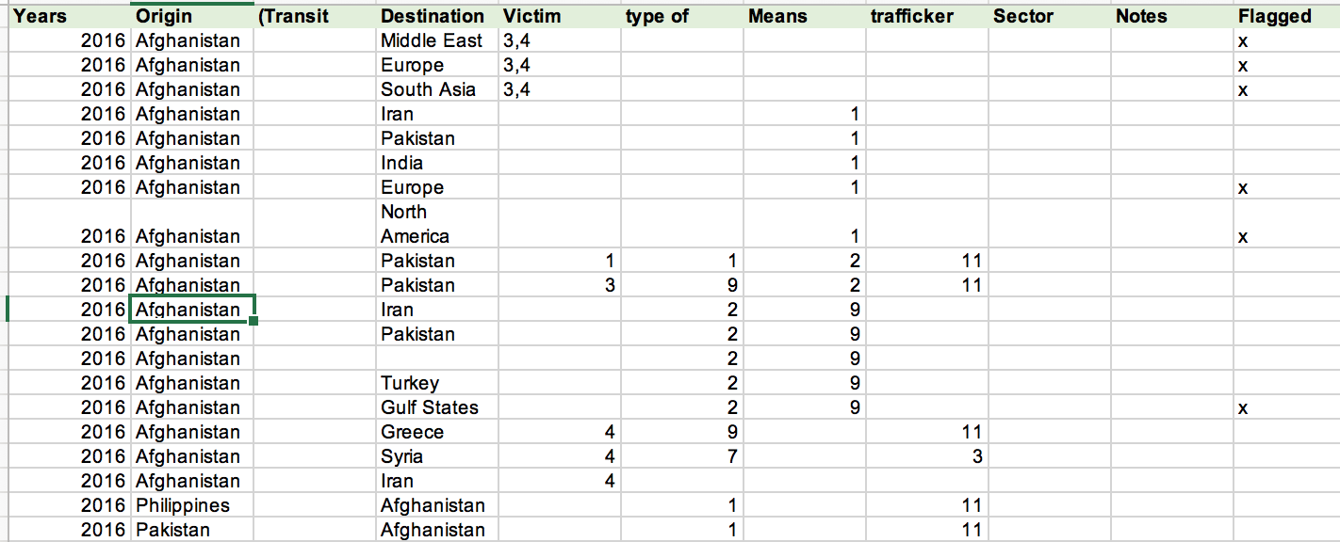
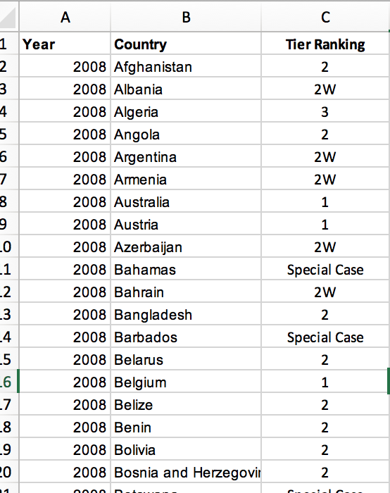
Dataset Description:
2 different excels files.
Directionality Coding: [ Origin , Destination , Type of trafficking ]
Human Trafficking Index Dataset : [ Tier Infomation ]

Slide 6
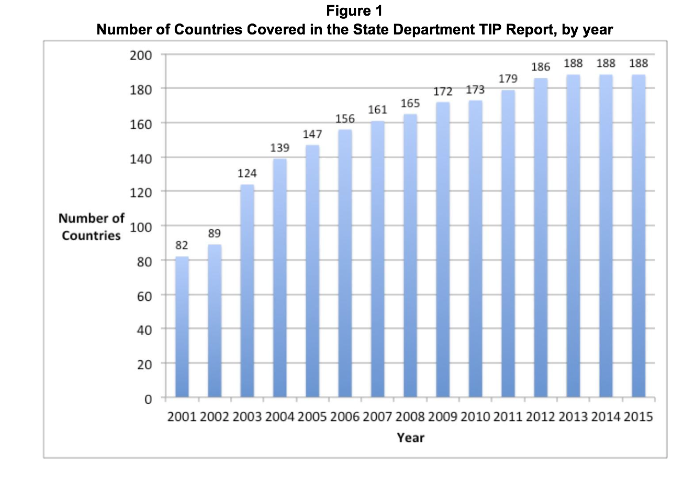
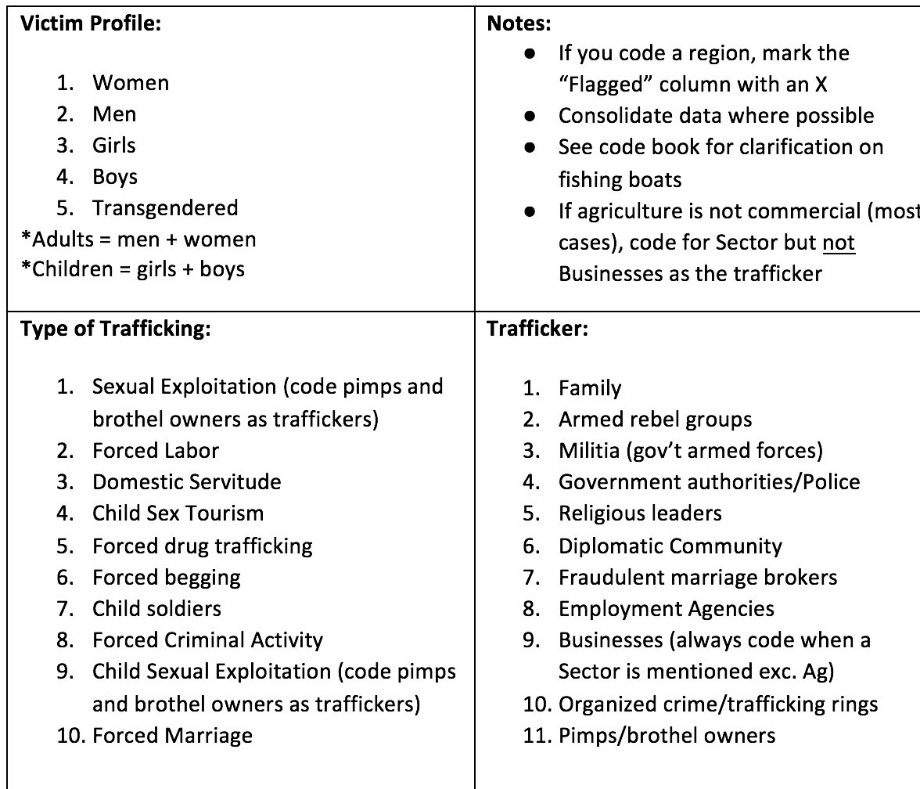
Tier Ranking and Codes info:
Source: DU Human Trafficking Code Index sheet

Slide 7

....CONT
Some Important Fields we considered:
Years - From 2008 to 2016
Source - Country of Origin
Destination Country
Type Of Trafficking:
Tier Ranking : Trafficking Victims
Protection Act’s(TVPA) minimum standards.

Slide 8
DATA MUNGING/WRANGLING :
Added Source and Destination Latitude and Longitudes using geolocator Library of Python.
Fixed country name region name anomaly.
Segregating Type of Trafficking column.
Updated Geojson to include tier ranking.

Slide 9
Data SCIENCE TOOLS SUMMARY:
Numpy, pandas : Data Processing
Holoviews : library for building flexible visualizations of
multidimensional data.
Cartopy : Designed for geospatial data processing in order to
produce maps.
Bokeh: Primary visualization tool
Folium:
Geoview:

Slide 10
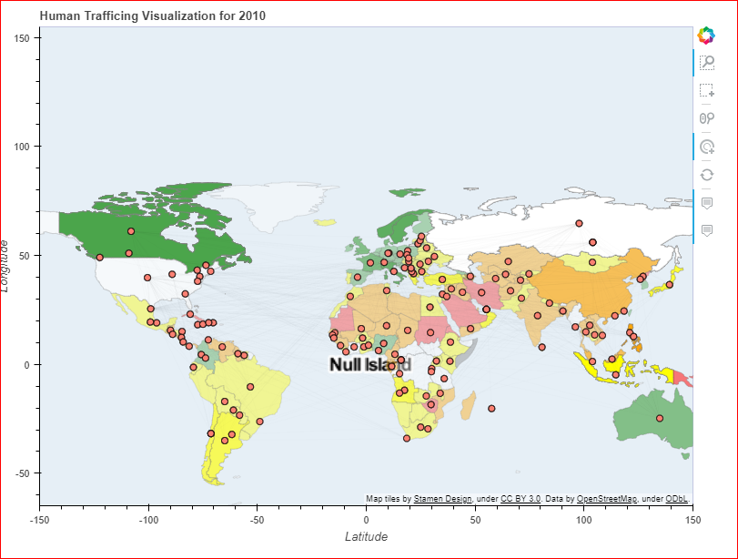
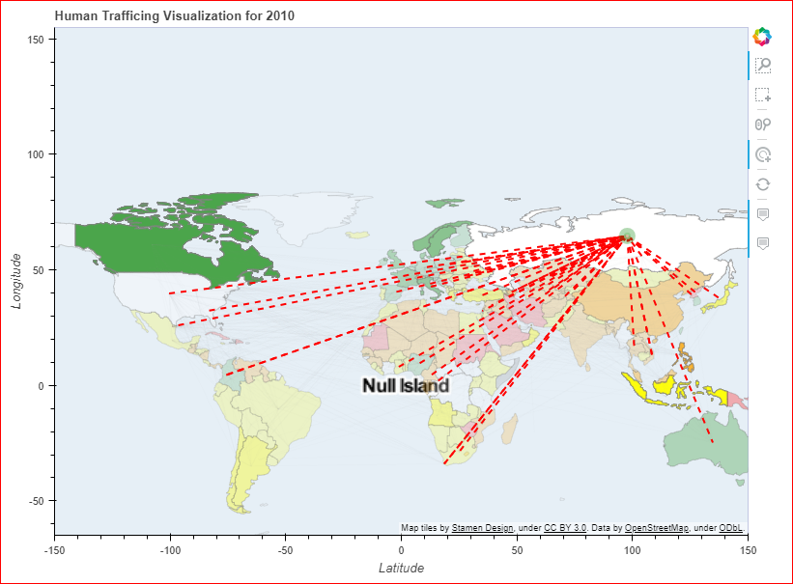
PRIMARY INTERATIVE GRAPH

Slide 11
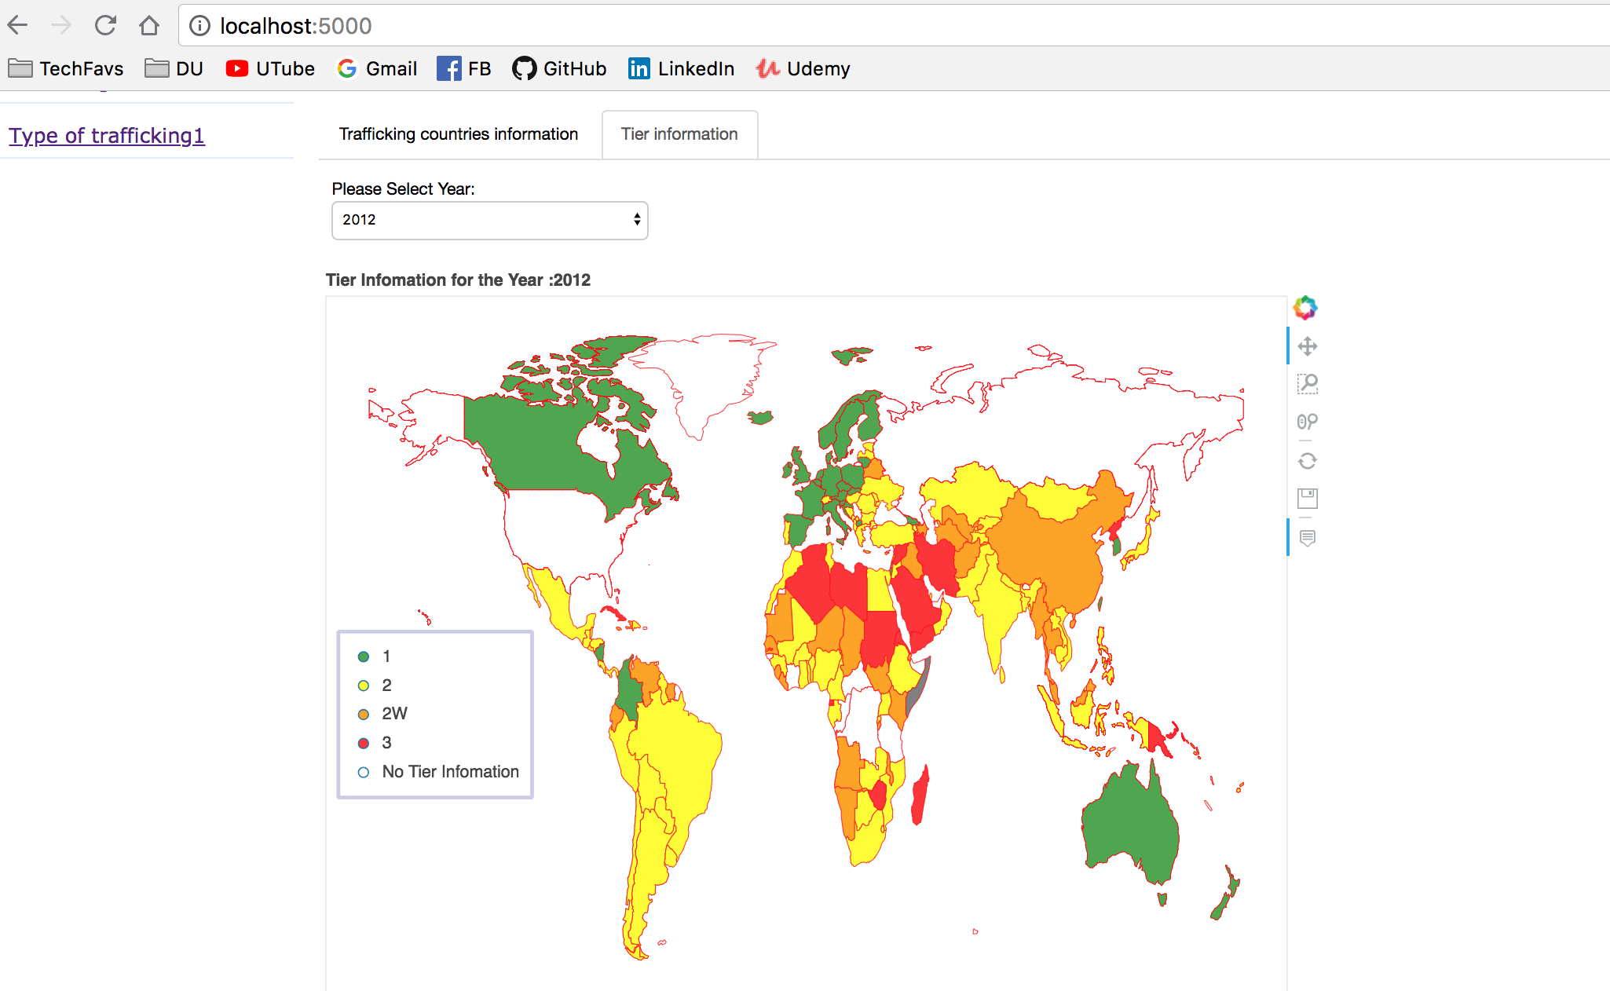
TIER RANKING GRAPH

Slide 12
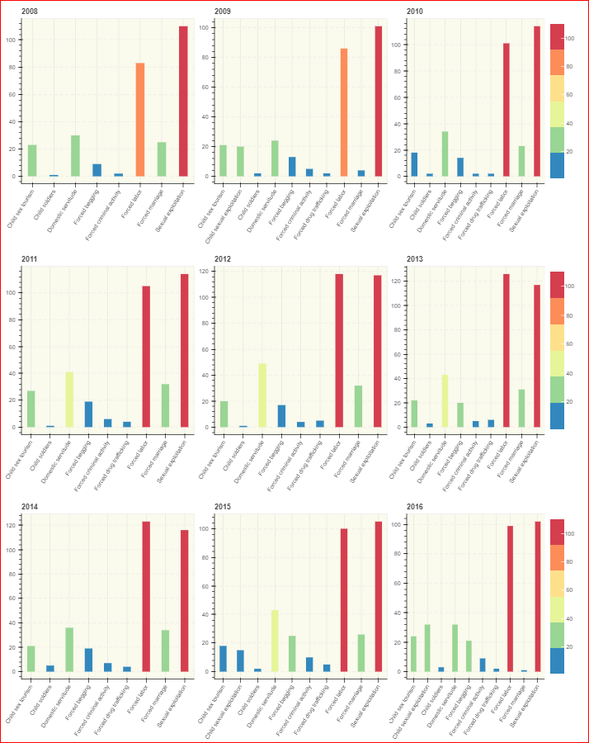
YEARWISE COUNT OF TYPE OF TRAFFICKING
Sexual Exploitation is more in every year

Slide 13
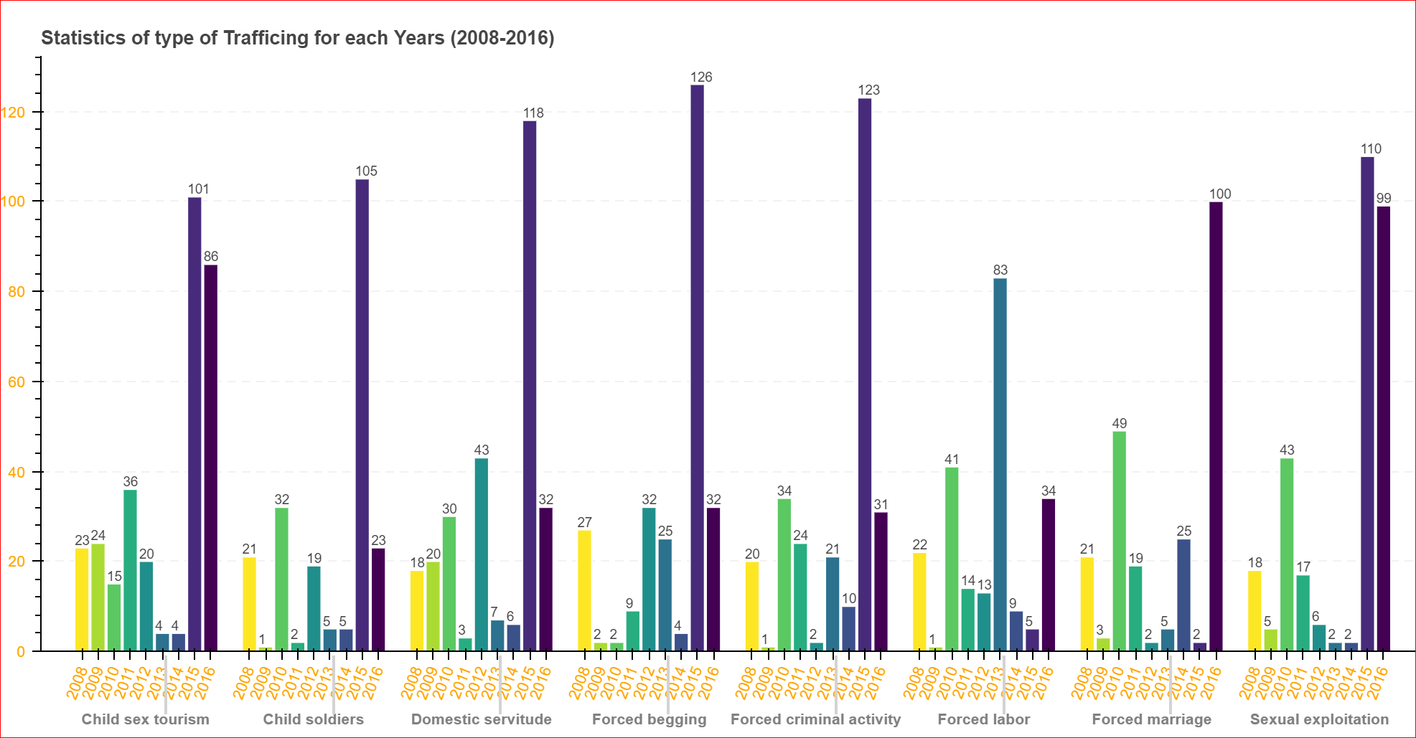
STATISTIC ON TYPE OF TRAFFICKING(2008-2016)
2015 : All trafficking was at High.

Slide 14

LOOKING FORWARD TO ...
Hover Information is Incomple.
More level of filter (Geoview vs Bokeh).
Option to load file for other year.

Slide 15

THANK YOU

